Slide 1
JavaScript
JavaScript is the most popular script-based programming language that support the development of both client and server components of web based applications.
It works in all major browsers, such as Internet Explorer, Firefox, Chrome, Opera, and Safari.
JavaScript was originally developed by Netscape replacing LiveScript.

Slide 2
What is JavaScript?
JavaScript was designed to add interactivity to HTML pages
JavaScript is a scripting language
A scripting language is a lightweight programming language
JavaScript is usually embedded directly into HTML pages
JavaScript is an interpreted language (means that scripts execute without preliminary compilation)

Slide 3
Are Java and JavaScript the same?
NO!
Java and JavaScript are two completely different languages in both concept and design!
JavaScript is a very free-form language compared to Java whereas Java is a class-based programming language designed for fast execution and type safety.

Slide 4
JavaScript | Java
1) JavaScript is interpreted (not complied) by client. | 1) Java is compiled byte codes downloaded from server, executed on client.
2) JavaScript is object-oriented. There is no distinction between types of objects. Inheritance is through the prototype mechanism, and properties and methods can be added to any object dynamically. | 2) Java is class-based. Objects are divided into classes and instances with all inheritance through the class hierarchy. Classes and instances cannot have properties or methods added dynamically.
3) In JavaScript, code is integrated with and embedded in HTML. | 3) Java uses applets that are distinct from HTML (accessed from HTML pages).
4) Variable data types are not declared (dynamic typing). | 4) Variable data types must be declared (static typing).

Slide 5
Database Connectivity:
Netscape has a product called ‘Live wire’, which permits server side , JavaScript code, to connect to Relational Database management systems (RDBMS) like oracle, My SQL server, My SQL etc ‘live wire’ database drivers also support a no of non-relational database.

Slide 6
Client Side JavaScript:
Client side java Script is embedded into a standard HTML program. JavaSript is embedded between the <script>…….</script> html tags.
These tags are embedded within the <head>……</head> or <body>…..</body> tags of the html program.
Java script is embedded into an html program because JavaScript uses the filename.html and HTTP protocol to transport itself from the web serve to the client’s browser where the JavaScript executes and processes client information.
Only a browser that is JavaScript enabled will be able to interpret JavaScript code.
Netscape communicator does this best as javascript is the natural language of NetScape communicator.

Slide 7
Server Based JavaScript
Server Based JavaScript programs are complied with HTML documents into a platform independent byte code format.
The server based scripts remain with the server and are loaded to perform any server side processing.
The HTML document loaded by the browser communicate with the server scripts to implement advance web applications that are distributed between the browser server and other server side programs such as database and electronic commerce applications.

Slide 8
Advantages of JavaScript:
An interpreted language:
It do not requires compilation steps.
2. Embedded within HTML:
JavaScript does not require any separate editor for program to be written, edited or compiled. It can be written in any text editor like notepad along with html tags and saved as fielname.html.
3. Minimal Syntax- easy to learn:
By learning few commands, simple rules of syntax, complete application can be built using JavaScript.

Slide 9
4. Quick development:
As JavaScript does not require time consuming compilation, scripts can be developed in short period of time.
5. Designed for simple, small programs:
Small programs can be easily written executed at an acceptable speed using JavaScript.
6. Performance:
Java Script can be written such that the html files are compact and quite small. It minimize storage requirements on the web server and download time for client.

Slide 10
7. Procedural capabilities:
Every programming language needs to support facilities such as condition checking, looping and branching.
8. Designed for programming user events:
It support object/event based programming.
9. Easy debugging and Testing:
Being an interpreted language, JavaScript are tested line by line, and errors are listed when encountered. Thus it is easy to locate errors, make changes and test without any difficulty.

Slide 11
10. Platform independence/Architectural Neutral:
Java Script is a programming language that is completely independent of the hardware on which it works. It is a language understood by any JavaScript enabled browser.
Thus JavaScript applications work on any machine that has an appropriate JavaScript enabled browser installed.

Slide 12
Limitation Of JavaScript
The major drawbacks of JavaScript are as follows:
JavaScript cannot be loaded in any and every browser. It requires a JavaScript enabled web browser like Netscape Navigator 2.0 or above and Internet Explorer 3.0 or above running on Windows95/98/NT. Older versions of browsers do not fully support JavaScript.
JavaScript cannot be used to write stand-alone applications. It has to be embedded within HTML for the browser to do its processing.

Slide 13
JavaScript stores data by virtue of HTTP cookies. Some of the information (such as, name, email-id etc.) can be stored in cookie, which can be used by the site when the user visits the site again. But it lacks other effective and persistent methods (such as, storing in a file, database etc.) of storing local data.
JavaScript has no support for Table objects.
It does not have any option of implementing threads within programs.
JavaScript does not support all of OOPS concept. It is object based, not object oriented. Inheritance is a very strong concept in any object oriented programming language. But JavaScript does not support inheritance as well.

Slide 14
Data Types:
JavaScript supports four primitive types of value and supports complex types such as arrays and objects.
Primitive types are number, string, Boolean and null type.
Number:
Consists of integer and floating point numbers and the special NaN (Not a Number) value.

Slide 15
Boolean:
Consists of the logical value true and false.
If true, value=1
If false, value=0
String:
Consists of string values that are enclosed in a single or double quotes.
Null:
Consists of a single value, null, which identifies a null, empty or nonexistent reference.
It is automatically converted to default values of other types when used in an expression

Slide 16
Embedding JavaScript In HTML
<script language=“text/JavaScript”>
JavaScript statements
</script>
Output:
Output1:
Comments
same as that of C++ and Java
// - for a single line comment.
/* ……
.. */ - for a multi-line comment
Output:

Slide 17
Variables
JavaScript variables can be declared by preceding the variable name with a keyword var.
For example,
var num;
var num1=100;
Radius=20; - is also valid
Output:

Slide 18
Scope of a variable
<script language=“text/JavaScript”>
var num = 100 global variable, scope global
function student()
{
var num = 40 local variable, scope within the function.
// JavaScript statements
document.write(“Value of local variable is ” + num)
}
document.write(“Value of global variable is ” + num)
</script>
Output:

Slide 19
Data Type Conversion
parseInt(string), parseFloat(string)
E.g.
var myint = 20
var mystring = “55”
result1= myint + mystring --------- results “2055”
result2 = myint + parseInt(mystring) --- results 75
Output:

Slide 20
Operators
The operators can be organized in the following categories:
Assignment
Arithmetic
Unary
String
Logical
Comparison
Bit Manipulation
Conditional
Special

Slide 21
Assignment
a = b
x += 5 // similar to x = x + 5
x -= 2 // similar to x = x – 2
x *= 5 // similar to x = x * 5
x /= 3 // similar to x = x / 3
x %= 10 // similar to x = x % 10
x = y = z = 10

Slide 22
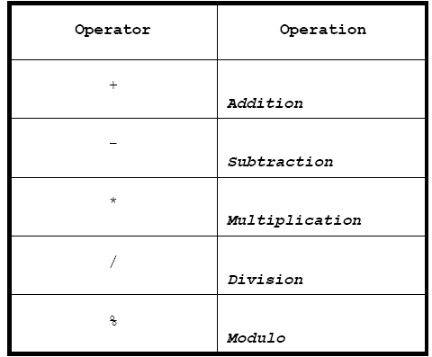
Arithmetic
Output:

Slide 23
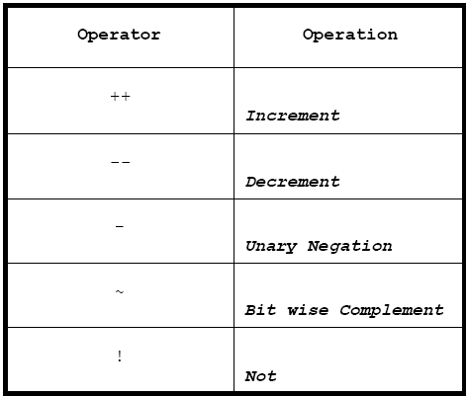
Unary

Slide 24
String
e.g.
mystr1 = “Khwopa”
mystr2 = “Engg”
name = mystr1 + mystr2
the + operator between the two strings concatenates them and name will have a value of “KhwopaEngg”

Slide 25
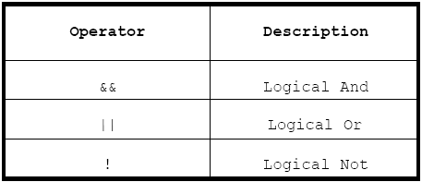
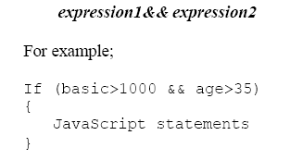
Logical

Slide 26
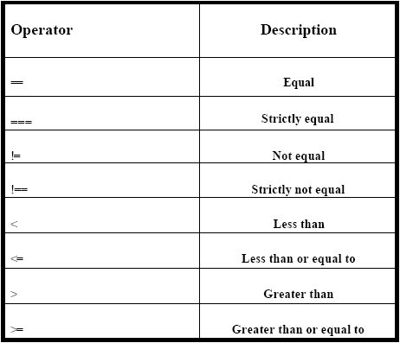
Comparison

Slide 27
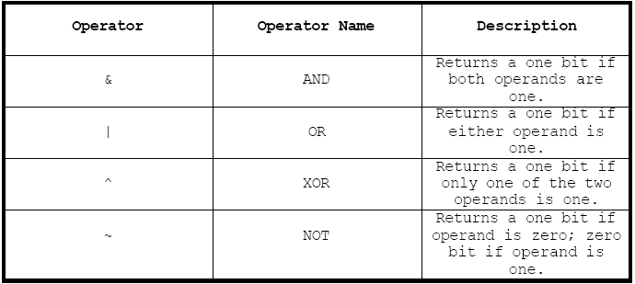
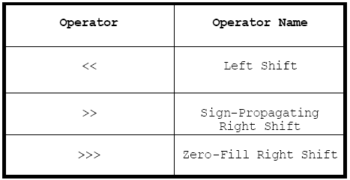
Bit Manipulation

Slide 28
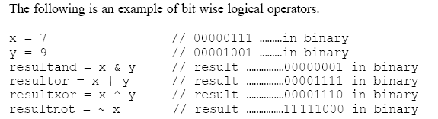

Output:
Output1:

Slide 29
Conditional
conditional operator - “? :”
p < q ? 20 : 25
Output:
Special
Delete Operator:
delete myarray[10]
New Operator
Typeof Operator
Output
Void Operator

Slide 30
Programming Constructs
Programming constructs in JavaScript include:
Conditional statements,
Loop statements,
Break statements, and
Continue statements.

Slide 31

The If Statement
if(i==2)
{
basic=1000;
salary=basic + 0.2*basic;
document.write(i + "." +" salary is " + salary + "<br>");
}

Slide 32
If...else Statement
Syntax
if (condition)
{
code to be executed if condition is true
}
else
{
code to be executed if condition is not true
}

Slide 33
Example
<script type="text/javascript">
var d = new Date();
var time = d.getHours();
if (time < 10)
{
document.write("Good morning!");
}
else
{
document.write("Good day!");
}
</script>

Slide 34
If...else if...else Statement
Syntax
if (condition1)
{
code to be executed if condition1 is true
}
else if (condition2)
{
code to be executed if condition2 is true
}
else
{
code to be executed if condition1 and condition2 are not true
}

Slide 35
Example
<script type="text/javascript">
var d = new Date();
var time = d.getHours();
if (time<10) {
document.write("<b>Good morning</b>");
}
else if (time>10 && time<16) { document.write("<b>Good day</b>"); }
else {
document.write("<b>Hello World!</b>");
}
</script>

Slide 36
The for Loop
Syntax
for(var=startvalue;var<=endvalue;var=var+increment)
{
code to be executed
}
Example:
<html> <body>
<script type="text/javascript">
var i=0;
for (i=0;i<=10;i++)
{ document.write("The number is " + i); document.write("<br />"); }
</script>
</body> </html>

Slide 37
The while loop
syntax:
while (var<=endvalue)
{
code to be executed
}
The do...while Loop
syntax:
do {
code to be executed
} while (var<=endvalue);

Slide 38
JavaScript For...In Statement
is used to loop (iterate) through the elements of an array or through the properties of an object.
Syntax
for (variable in object)
{
code to be executed
}

Slide 39
<html> <body>
<script type="text/javascript">
var x;
var mycars = new Array();
mycars[0] = "Saab";
mycars[1] = "Volvo";
mycars[2] = "BMW";
for (x in mycars) {
document.write(mycars[x] + "<br />");
}
</script>
</body> </html>

Slide 40
Arrays
Defining Arrays
var mycars=new Array();//var mycars=new Array(3);
mycars[0]="Saab";
mycars[1]="Volvo";
mycars[2]="BMW";
or
var mycars=new Array("Saab","Volvo","BMW");
Accessing Arrays
document.write(mycars[0]);

Slide 41
Switch Statement
Syntax
switch(n)
{
case 1:
execute code block 1
break;
case 2:
execute code block 2
break;
default:
code to be executed if n is different from case 1 and 2
}

Slide 42
JavaScript Popup/Dialog Boxes
Alert Box
An alert box is often used if you want to make sure information comes through to the user.
When an alert box pops up, the user will have to click "OK" to proceed.
Syntax:
alert("sometext");
Output:
Confirm Box
A confirm box is often used if you want the user to verify or accept something.

Slide 43
When a confirm box pops up, the user will have to click either "OK" or "Cancel" to proceed.
If the user clicks "OK", the box returns true. If the user clicks "Cancel", the box returns false.
Syntax:
confirm("sometext");
Output: Prompt Box
A prompt box is often used if you want the user to input a value before entering a page.
When a prompt box pops up, the user will have to click either "OK" or "Cancel" to proceed after entering an input value.
If the user clicks "OK" the box returns the input value. If the user clicks "Cancel" the box returns null.
Syntax:
prompt("sometext","defaultvalue");
Output:

Slide 44
JavaScript Functions
To keep the browser from executing a script when the page loads
A function contains code that will be executed by an event or by a call to the function.
You may call a function from anywhere within a page (or even from other pages if the function is embedded in an external .js file)
Functions can be defined both in the <head> and in the <body> section of a document. However, to assure that a function is read/loaded by the browser before it is called, it could be wise to put functions in the <head> section.

Slide 45
The syntax for creating a function is:
function functionname(var1,var2,...,varX)
{
some code
}
or
function functionname()
{
some code
}
Output:

Slide 46
The return Statement
Example
function prod(a,b)
{
x=a*b;
return x;
}
To call the function
Example
product=prod(2,3);
Output:

